Slide 1


React & Firebase
#2 Firebase Database & Storage

Slide 2


?
How to Connect
React Project to
Firebase Database

Slide 3

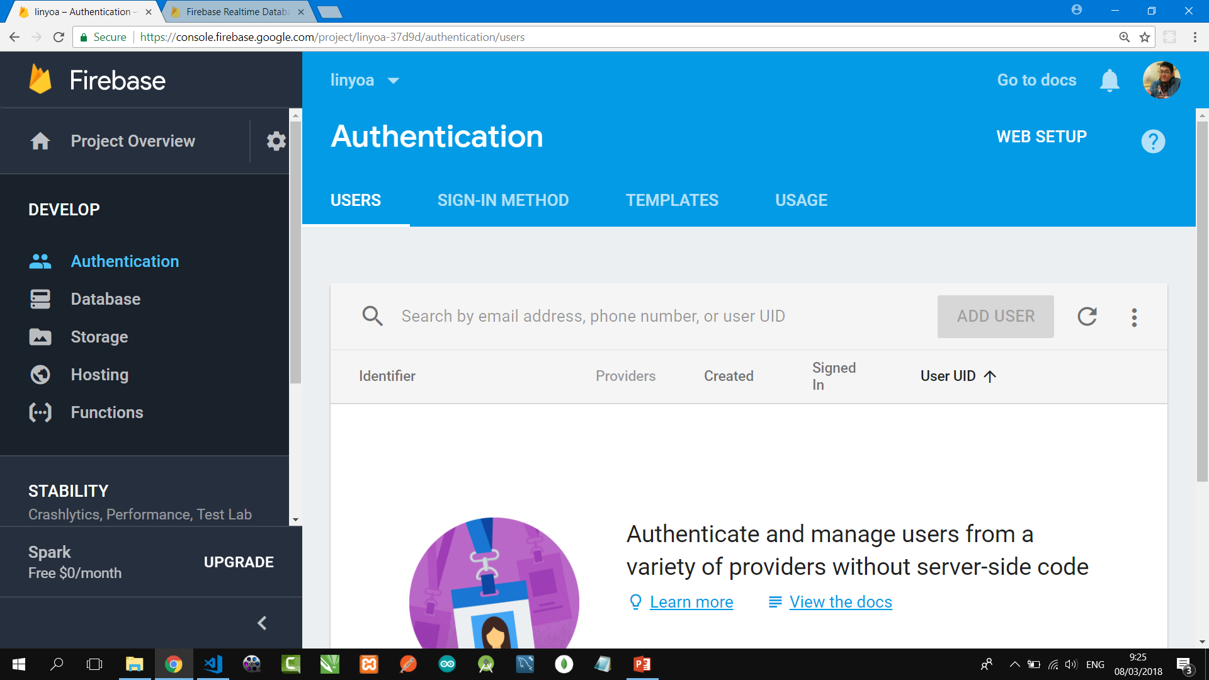
Firebase Realtime Database is a cloud-hosted database. Data is stored as JSON and synchronized in realtime to every client.
When you build cross-platform apps with our iOS, Android, and JavaScript SDKs, all of your clients share one Realtime Database instance and automatically receive updates with the newest data.

Slide 4
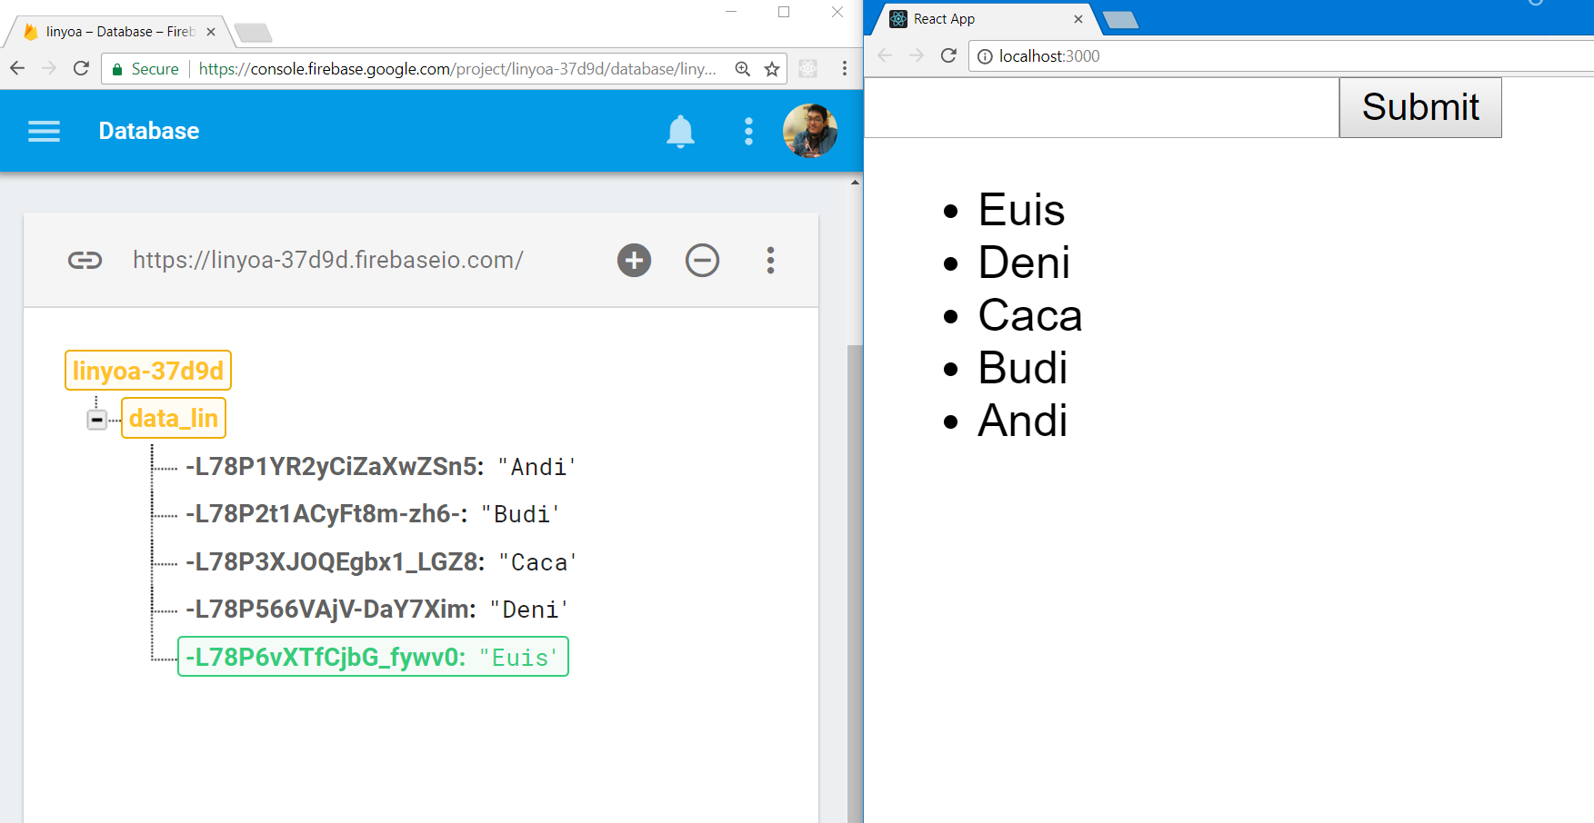
React & Firebase Database

Slide 5
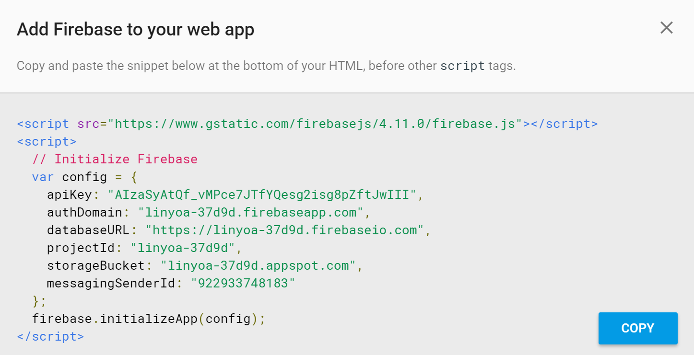
#1 Setup Firebase Database
On your project dir, install Firebase Package!
$ npm install firebase --save
On Firebase Database project, click Project Overview → Add Firebase to Your Web App then copy its snippet code.

Slide 6
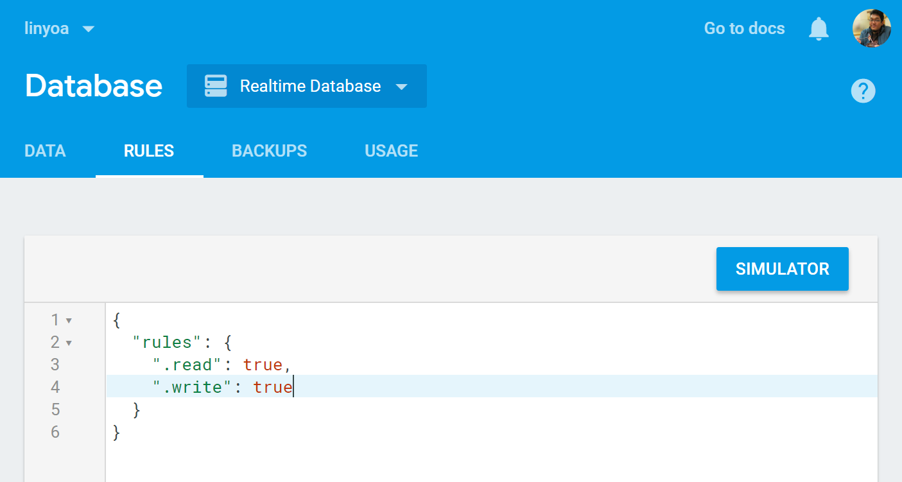
#1 Setup Firebase Database
On Firebase Database Rules (also on JSON file database.rules.json if any), set all its value to true:
{
"rules": {
".read": true,
".write": true
}
}

Slide 7
#2 Create/Prepare Your React App
Install create-react-app utility globally on your PC (if you have not done yet before)
$ npm install -g create-react-app
Create a new react app or prepare yours
$ create-react-app linyoa
$ cd linyoa
Make sure that it runs successfully
$ npm start

Slide 8
#2 Create/Prepare Your React App
Install Firebase packages needed:
$ npm install -g firebase-tools
$ npm install firebase

Slide 9
src/fire.js
#3 Insert Snippet
Create src/fire.js
import firebase from 'firebase';
var config = {
apiKey: "a1b2c3d4e5f6g7h8i9j0",
authDomain: "linyoa-37d9d.firebaseapp.com",
databaseURL: "https://linyoa-37d9d.firebaseio.com",
projectId: "linyoa-37d9d",
storageBucket: "linyoa-37d9d.appspot.com",
messagingSenderId: "1234567890"
};
var fire = firebase.initializeApp(config);
export default fire;

Slide 10
src/App.js
#4 Set Reference to
Firebase Database
import React, { Component } from 'react';
import fire from './fire';
class App extends Component {
constructor(props) {
super(props);
this.state = { messages: [] };
}
componentWillMount(){
let messagesRef = fire.database().ref('data_lin').orderByKey().limitToLast(100);
messagesRef.on('child_added', snapshot => {
let message = { text: snapshot.val(), id: snapshot.key };
this.setState({ messages: [message].concat(this.state.messages)
});
})
}

Slide 11
src/App.js
#4 Set Reference to
Firebase Database
addMessage(e){
e.preventDefault();
fire.database().ref('data_lin').push( this.inputEl.value );
this.inputEl.value = '';
}
render() {
return (
<form onSubmit={this.addMessage.bind(this)}>
<input type="text" ref={ el => this.inputEl = el }/>
<input type="submit"/>
<ul>
{
this.state.messages.map( message => <li
key={message.id}>{message.text}</li> )
}
</ul>
</form>
);}}
export default App;

Slide 12
React & Firebase Database

Slide 13
?
How to Connect
React Project to
Firebase Storage

Slide 14
Firebase Storage is a powerful, simple, and cost-effective object storage service built for Google scale. The Firebase SDKs for Cloud Storage add Google security to file uploads and downloads for your Firebase apps, regardless of network quality.
You can use our SDKs to store images, audio, video, or other user-generated content. On the server, you can use Google Cloud Storage, to access the same files.

Slide 15
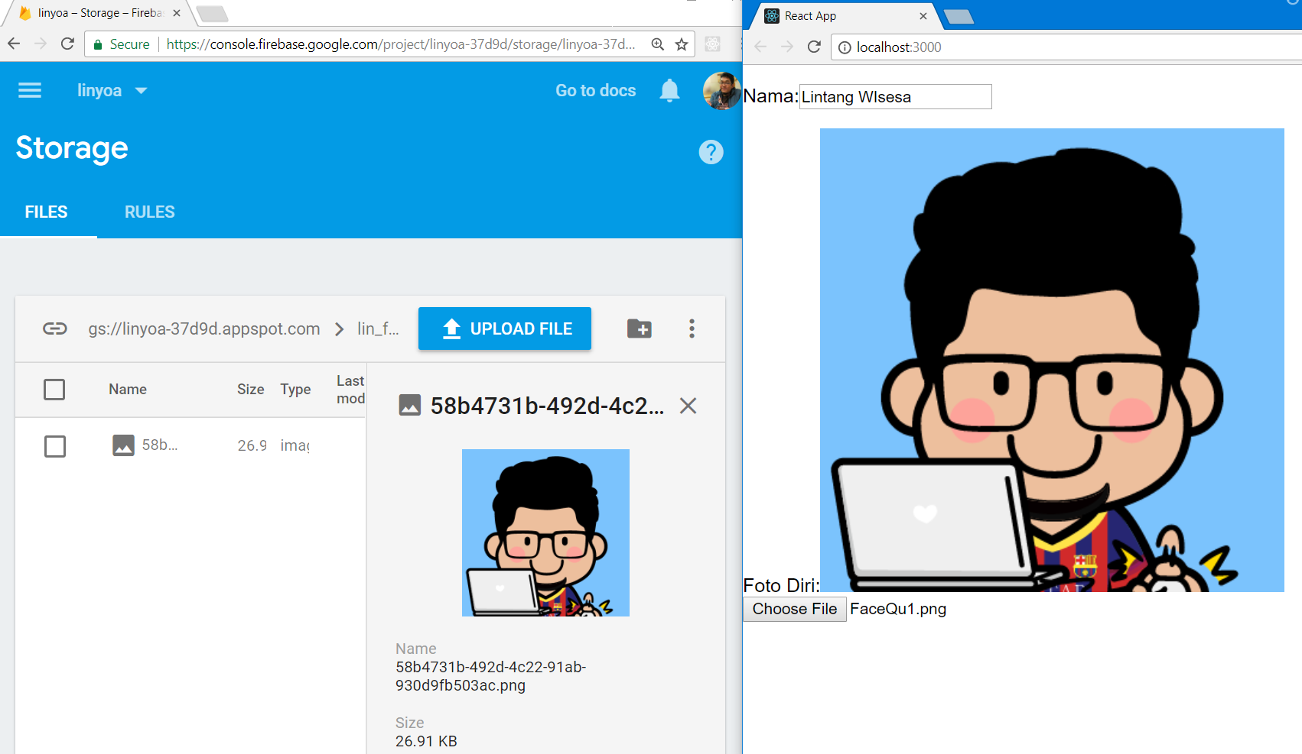
React & Firebase Storage

Slide 16
#1 Setup Firebase Storage
Create a new Firebase project, or simply you can use your old project too.
On Firebase project, click Project Overview → Add Firebase to Your Web App then copy its snippet code.

Slide 17
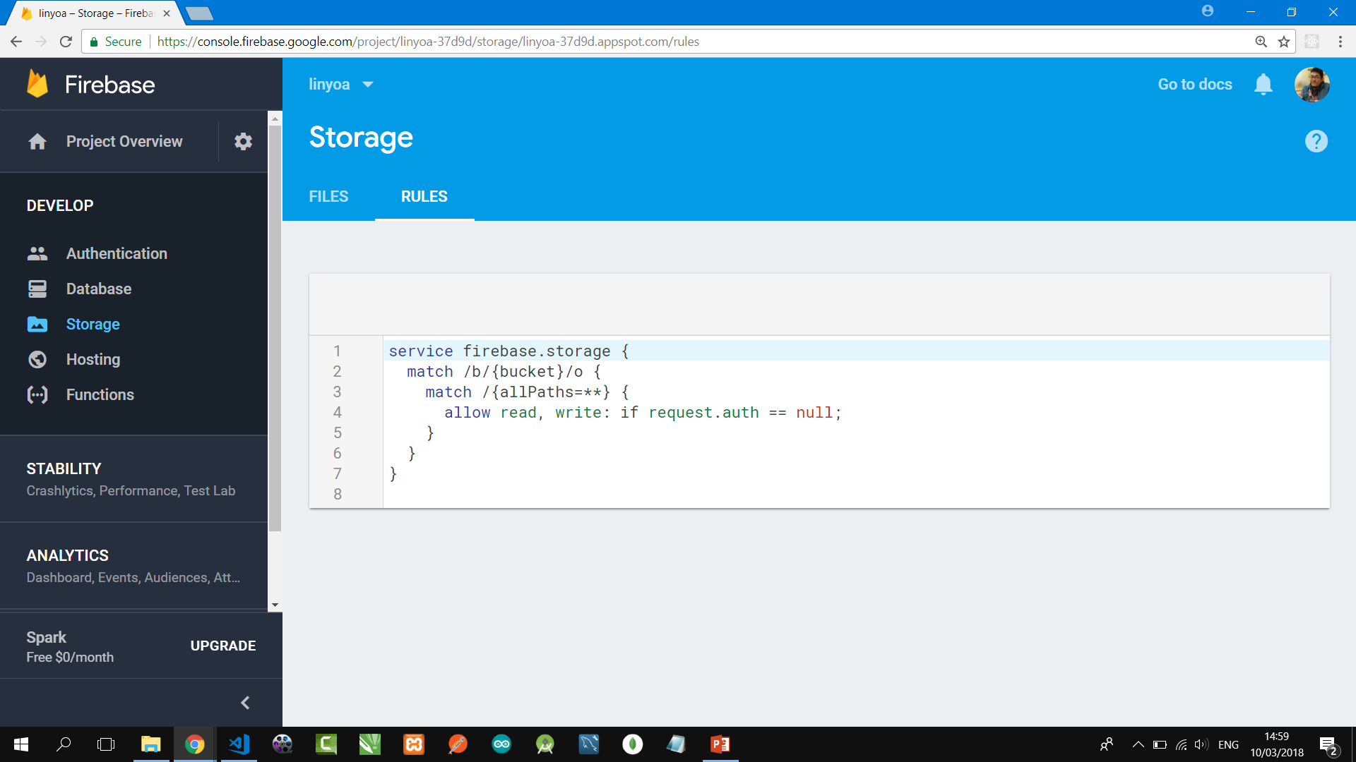
#1 Setup Firebase Storage
On Firebase Storage Rules, turn off auth request by set its code as following, then publish it:
service firebase.storage {
match /b/{bucket}/o {
match /{allPaths=**} {
allow read, write: if request.auth == null;
}
}
}

Slide 18
#2 Create/Prepare Your React App
Install create-react-app utility globally on your PC (if you have not done yet before)
$ npm install -g create-react-app
Create a new react app or prepare yours
$ create-react-app linyoa
$ cd linyoa
Make sure that it runs successfully
$ npm start

Slide 19
#2 Create/Prepare Your React App
Install Firebase packages needed:
$ npm install -g firebase-tools
$ npm install firebase
$ npm install react-firebase-file-uploader

Slide 20
src/fire.js
#3 Insert Snippet
Create src/fire.js
import firebase from 'firebase';
var config = {
apiKey: "a1b2c3d4e5f6g7h8i9j0",
authDomain: "linyoa-37d9d.firebaseapp.com",
databaseURL: "https://linyoa-37d9d.firebaseio.com",
projectId: "linyoa-37d9d",
storageBucket: "linyoa-37d9d.appspot.com",
messagingSenderId: "1234567890"
};
var fire = firebase.initializeApp(config);
export default fire;

Slide 21
src/App.js
#4 Set Reference to
Firebase Storage
import React, { Component } from 'react';
import fire from './fire';
import firebase from 'firebase';
import FileUploader from 'react-firebase-file-uploader';
class ProfilePage extends Component {
state = {
username: '',
avatar: '',
isUploading: false,
progress: 0,
avatarURL: ''
};

Slide 22
src/App.js
#4 Set Reference to
Firebase Storage
handleChangeUsername = (event) => this.setState({username: event.target.value});
handleUploadStart = () => this.setState({isUploading: true, progress: 0});
handleProgress = (progress) => this.setState({progress});
handleUploadError = (error) => {
this.setState({isUploading: false});
console.error(error);
}
handleUploadSuccess = (filename) => {
this.setState({avatar: filename, progress: 100, isUploading: false});
fire.storage().ref('lin_foto').child(filename).getDownloadURL().then(url => this.setState({avatarURL: url}));
};

Slide 23
src/App.js
#4 Set Reference to
Firebase Storage
render() {
return (
<div>
<form>
<p><label>Nama:</label>
<input type="text" value={this.state.username} name="username" onChange={this.handleChangeUsername} />
</p><label>Foto Diri:</label>
{this.state.isUploading && <p> Process: {this.state.progress}</p>}
{this.state.avatarURL &&
<img src={this.state.avatarURL} alt="ok" />}
<FileUploader accept="image/*" name="avatar" randomizeFilename
storageRef={fire.storage().ref('lin_foto')}
onUploadStart={this.handleUploadStart}
onUploadError={this.handleUploadError}
onUploadSuccess={this.handleUploadSuccess}
onProgress={this.handleProgress}
/>
</form>
</div>
);}}
export default ProfilePage;

Slide 24
React & Firebase Storage

Slide 25
React & Firebase
#2 Firebase Database & Storage

